Slide 1
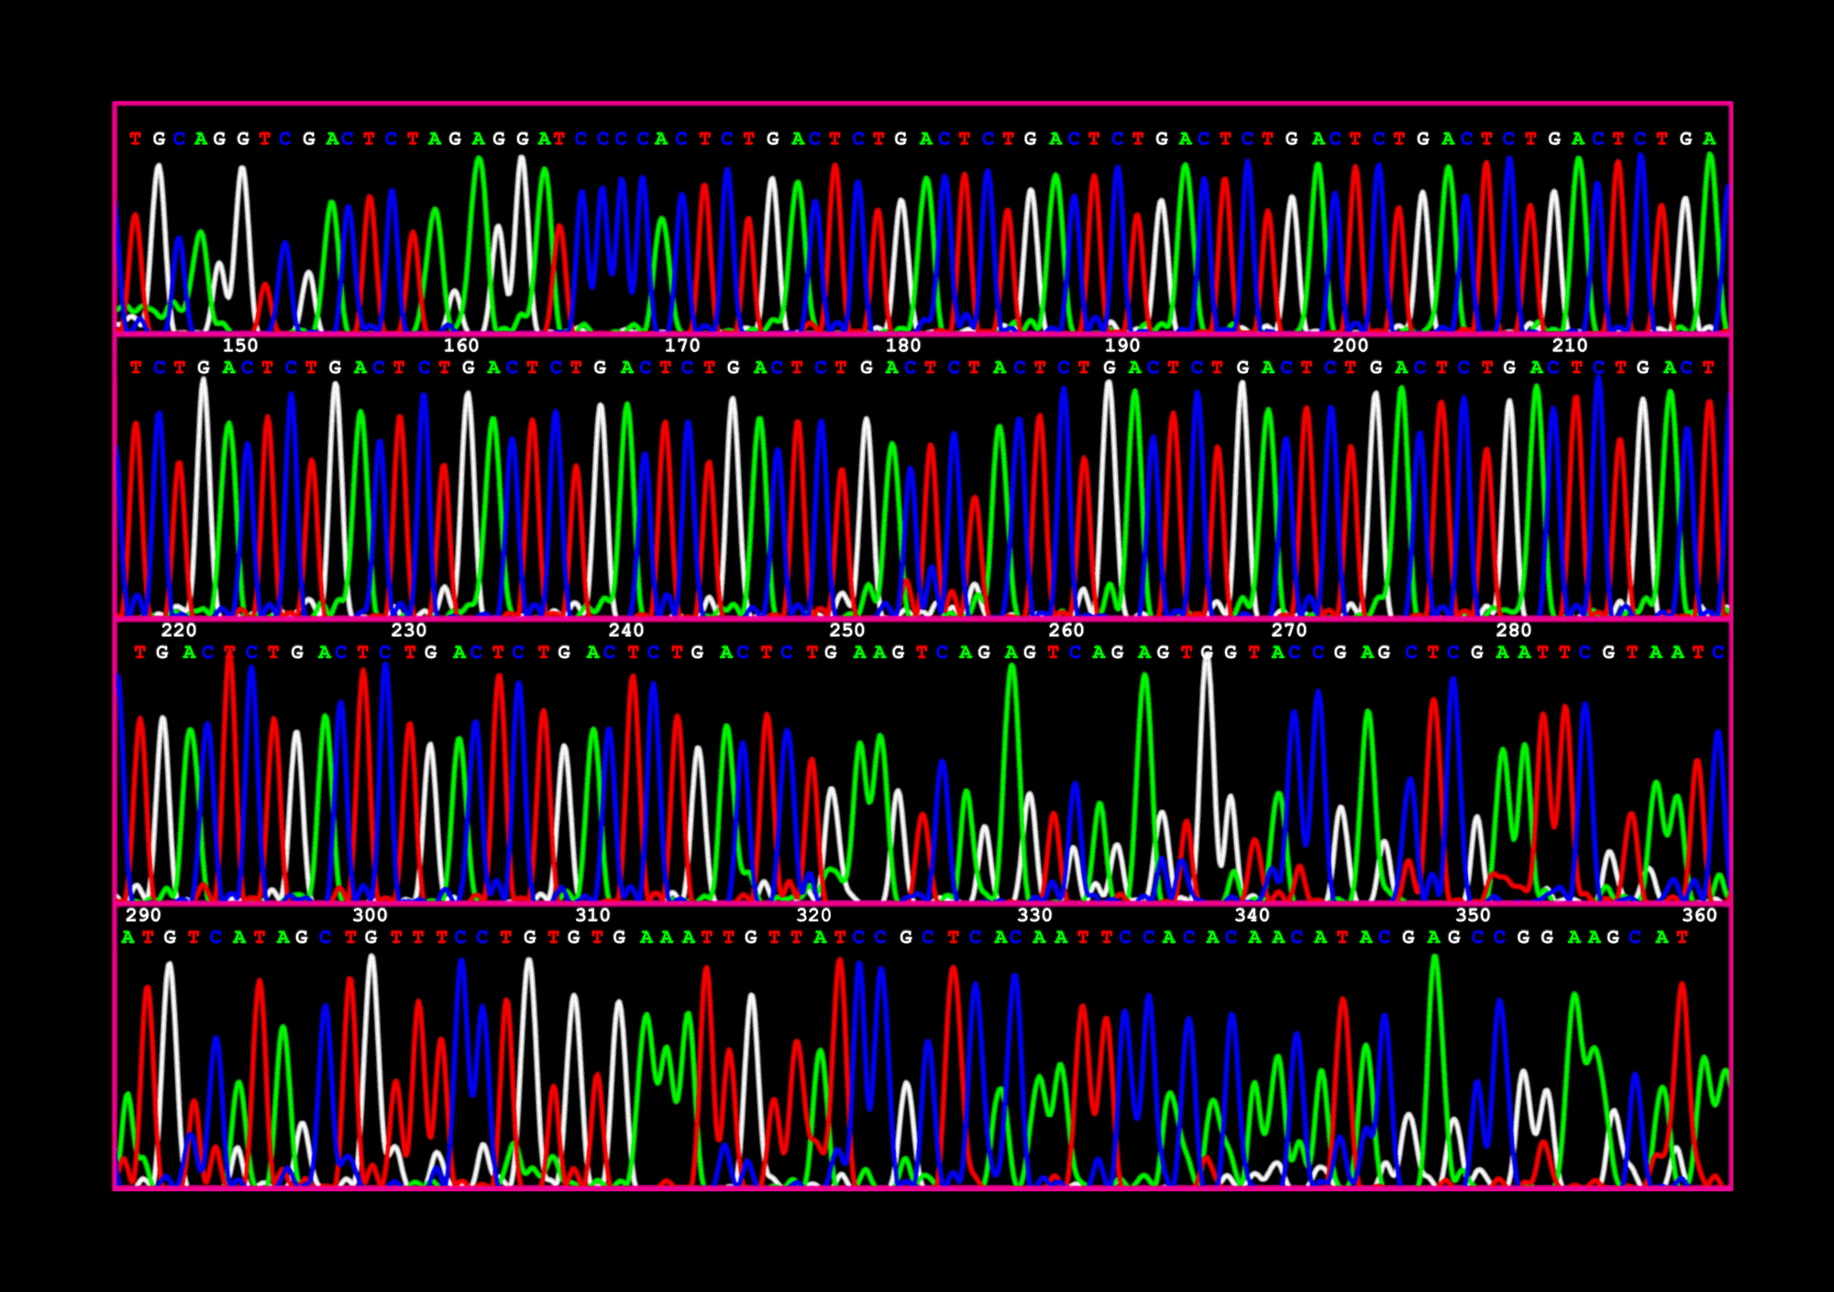

Sequencing Methods Overview
Exploring DNA Sequencing Techniques
Swayam Roll no.114
Mudassir Roll no.128
Nayan Roll no.110
1

Slide 2

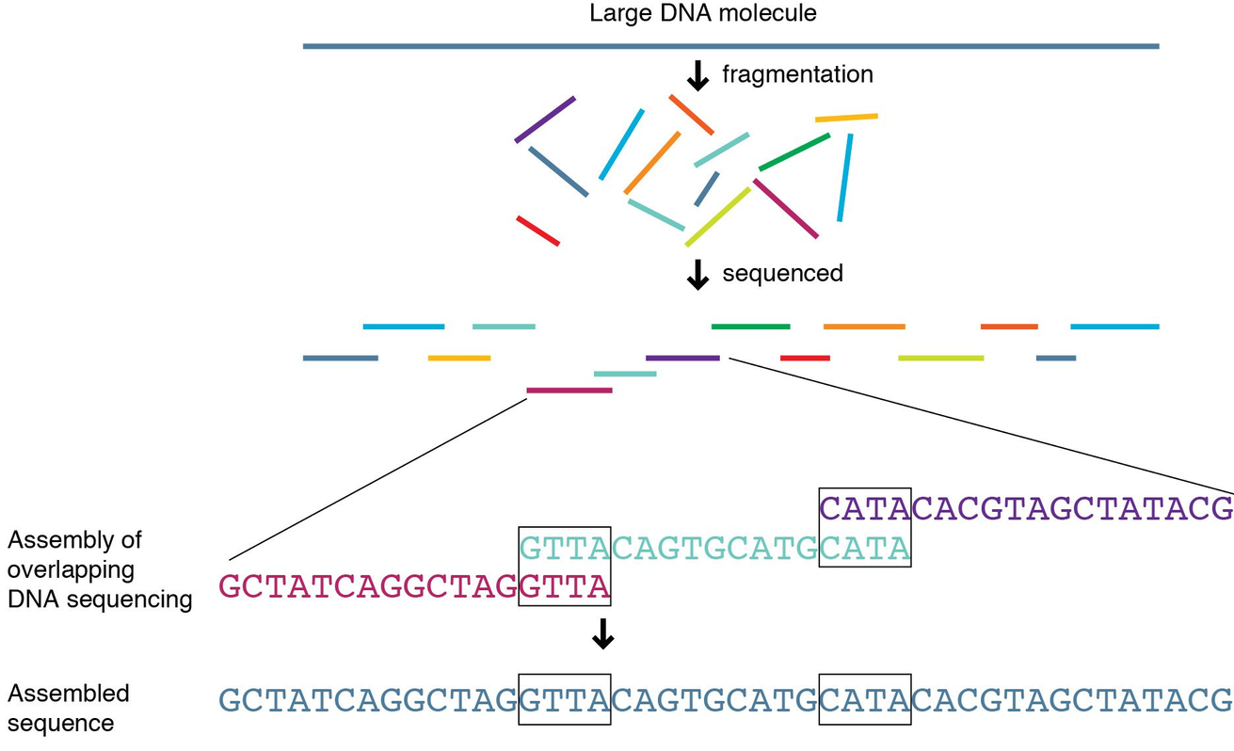
Introduction
The process involves identifying the exact sequence of nucleotides (A, T, C, G) in a DNA molecule.
This advancement has transformed our comprehension of life's basic components.
It has become an essential asset in diverse areas such as genomics, molecular biology, medical diagnostics, and evolutionary research.
2

Slide 3
Sequencing Methods
04
03
Nanopore Sequencing
02
Nanopore sequencing detects DNA bases by monitoring disruptions in electrical current as DNA strands pass through nanoscale protein pores.
Single Molecule Real-Time Sequencing (SMRT)
01
Single Molecule Real-Time Sequencing (SMRT) is a method of DNA sequencing that involves the detection of the release of light that occurs when nucleotides are incorporated into a growing DNA chain.
Ion Semiconductor Sequencing
Sequencing by Synthesis
Ion semiconductor sequencing is a method of DNA sequencing that is based on the detection of hydrogen ions that are released during DNA synthesis.
Sequencing by synthesis involves the detection of the nucleotides as they are incorporated into a growing DNA strand.
3

Slide 4
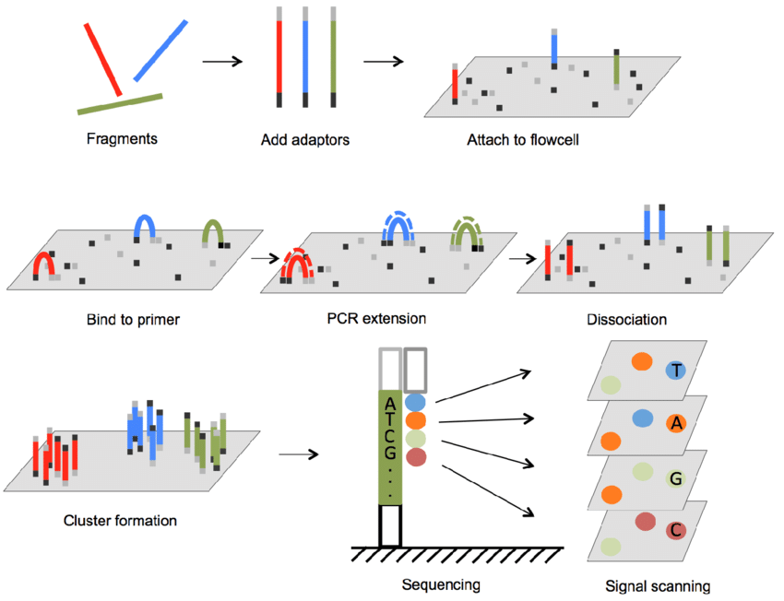
Sequencing by Synthesis
Also known as Cycle Sequencing or Sequencing by Synthesis (SBS), is a widely used method for determining the order of nucleotides in a DNA molecule. This technique is employed by popular platforms such as Illumina and has become a cornerstone of modern genomics research.
The principle behind Sequencing by Synthesis involves the use of fluorescently labeled nucleotides and a cyclical process of nucleotide incorporation, imaging, and cleavage.
SBS technology
source: Researchgate
4

Slide 5
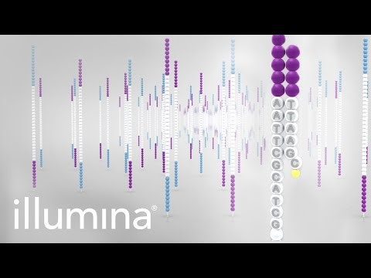
Sequencing by Synthesis
5

Slide 6
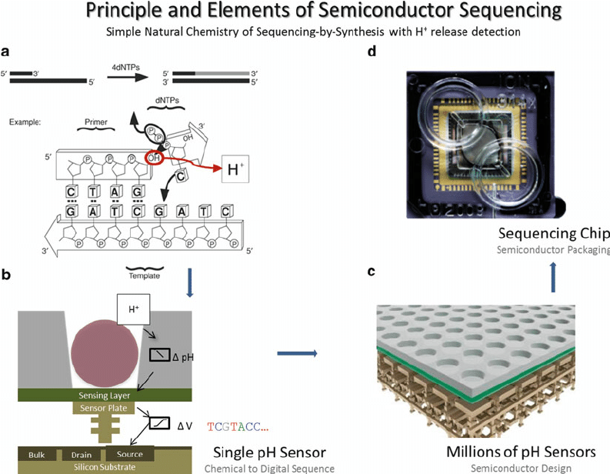
Ion Semiconductor Sequencing
Also known as Ion Torrent Sequencing, is a unique method developed by Ion Torrent (now part of Thermo Fisher Scientific). This technology revolutionized DNA sequencing by eliminating the need for fluorescent labeling and optical detection, instead relying on the direct detection of hydrogen ions released during DNA synthesis.
The principle behind Ion Semiconductor Sequencing is based on the detection of pH changes caused by the release of hydrogen ions (H+) during the incorporation of nucleotides into the growing DNA strand..
Ion Semiconductor Sequencing
source: Researchgate
6

Slide 7
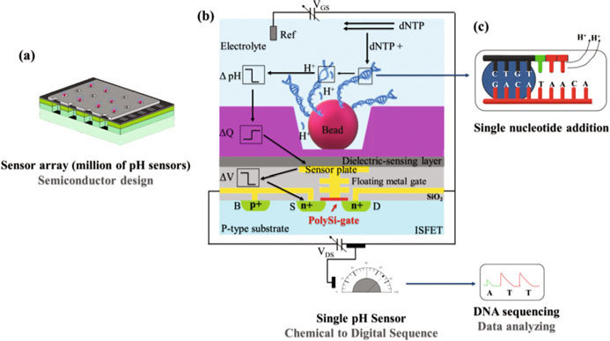
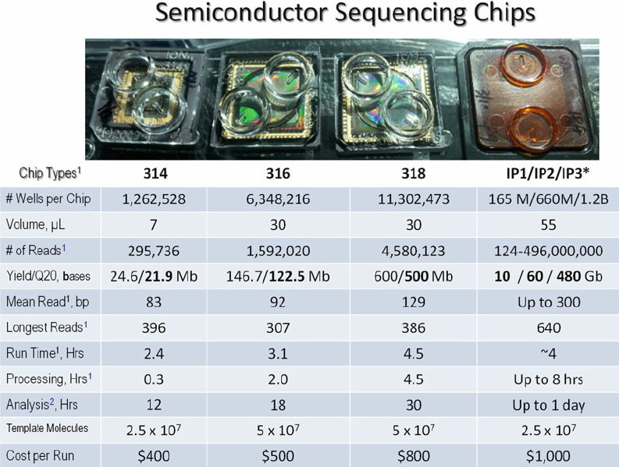
Ion Semiconductor Sequencing
source: Researchgate
7

Slide 8
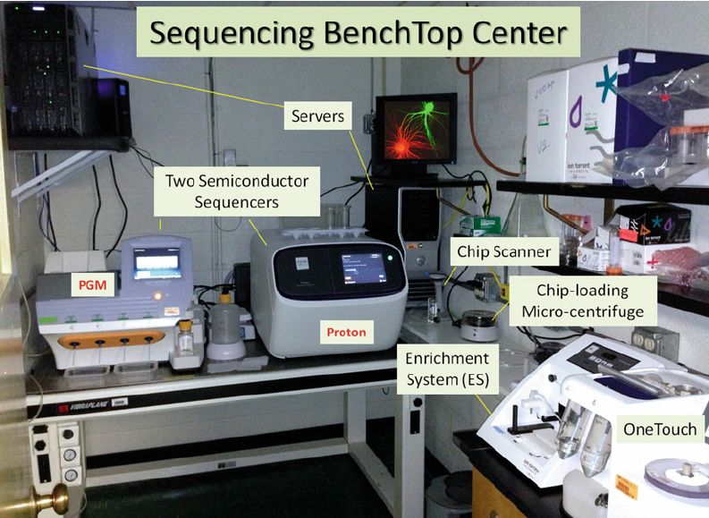
Ion Semiconductor Sequencing offers fast run times, scalability, and the ability to sequence small to medium-sized genomes or targeted regions. However, it generally produces shorter read lengths compared to some other methods and can be more prone to errors in homopolymer regions (consecutive repeats of the same nucleotide).
Despite these limitations, Ion Torrent Sequencing has found applications in various fields, including microbial genomics, targeted sequencing, and gene expression analysis, due to its speed, cost-effectiveness, and ease of use.
8

Slide 9
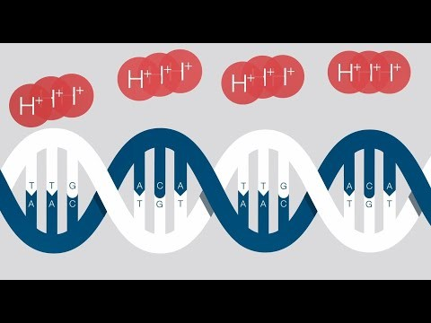
9

Slide 10
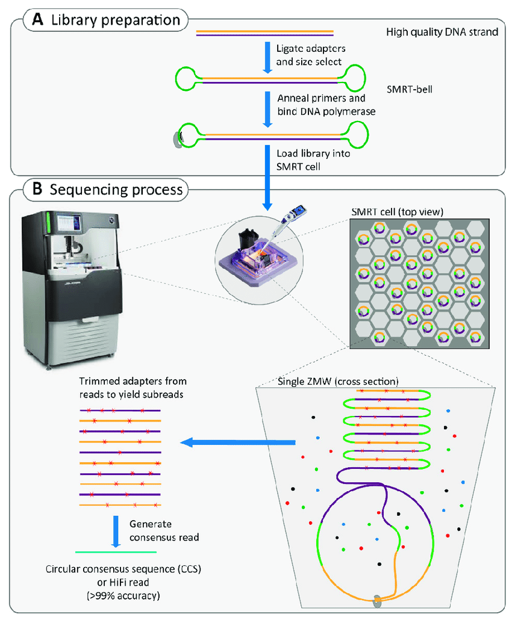
SMRT (Single-Molecule Real-Time) Sequencing
SMRT Sequencing, developed by Pacific Biosciences, is a groundbreaking technology that revolutionized DNA sequencing by enabling the real-time observation of DNA synthesis at the single-molecule level. This method provides long read lengths and the ability to detect base modifications, making it a powerful tool for various applications.
The principle behind SMRT Sequencing involves the use of zero-mode waveguides (ZMWs), which are tiny wells with dimensions smaller than the wavelength of visible light. These ZMWs allow the observation of individual DNA polymerase molecules as they synthesize new DNA strands.
10

Slide 11
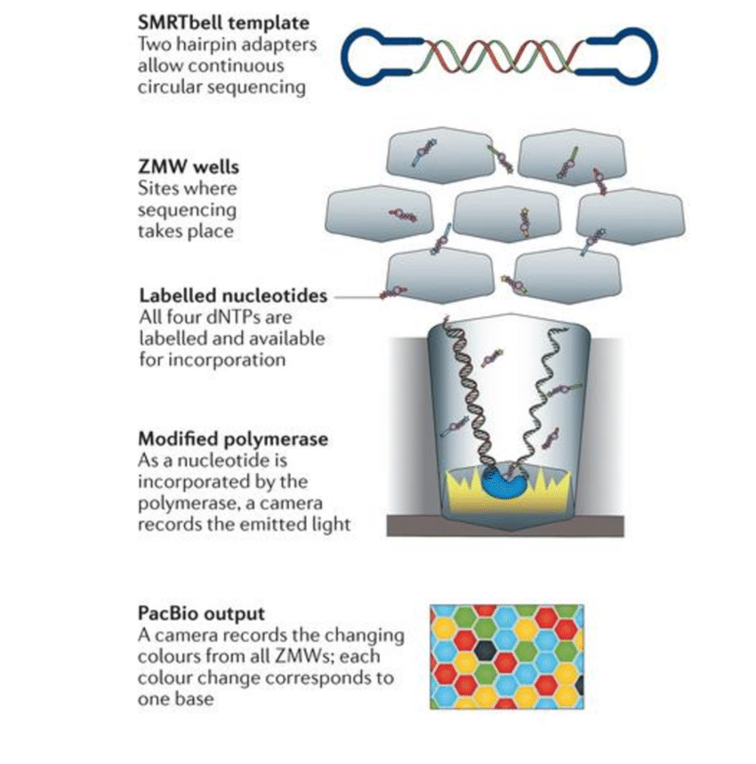
SMRT chip or cell (aluminium) contains approx. 10,000 ZMW’s.
ZMW is a Nano well with a diameter of 70 mm and 100 nm of depth & volume of 20 zeptolitres.
Illuminated from below (Nanophotonic Confinement Structure).
Single DNA Polymerase.
Genomic DNA is fragmented & denatured.
Each ssDNA ~10,000 nu
Know Oligonucleotide is attached & a primer complementary to it is introduced.
Allowed to diffuse on the CHIP.
One ssDNA in one well.
dNTP’s are allowed to diffuse ( dATP(BLUE), dGTP(GREEN), dTTP(YELLOW), dCTP(RED)
Single nucleotides are incorporated at a time, a fluorescent tag is cleaved off & fluorescence is detected by a highly sensitive detector..
Real-Time.
Tiny detection volume provides a 1000-fold improvement in the reduction of background noise.
SMRT technology
source: Researchgate
11

Slide 12
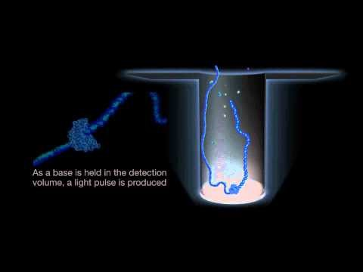
12

Slide 13

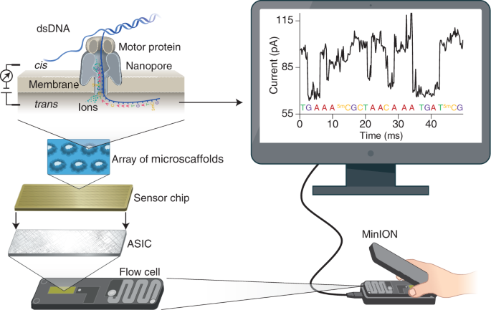
Nanopore Sequencing
It’s ability to sequence long DNA fragments in real-time without the need for amplification or labeling. This technology, pioneered by Oxford Nanopore Technologies, offers a unique approach to DNA sequencing by monitoring changes in electrical current as DNA molecules pass through nanoscale pores.
The principle behind Nanopore Sequencing relies on the detection of characteristic disruptions in the ionic current as DNA strands are threaded through a protein nanopore embedded in an electrically resistant membrane.
Nanopore Sequencing
source: Researchgate
13

Slide 14
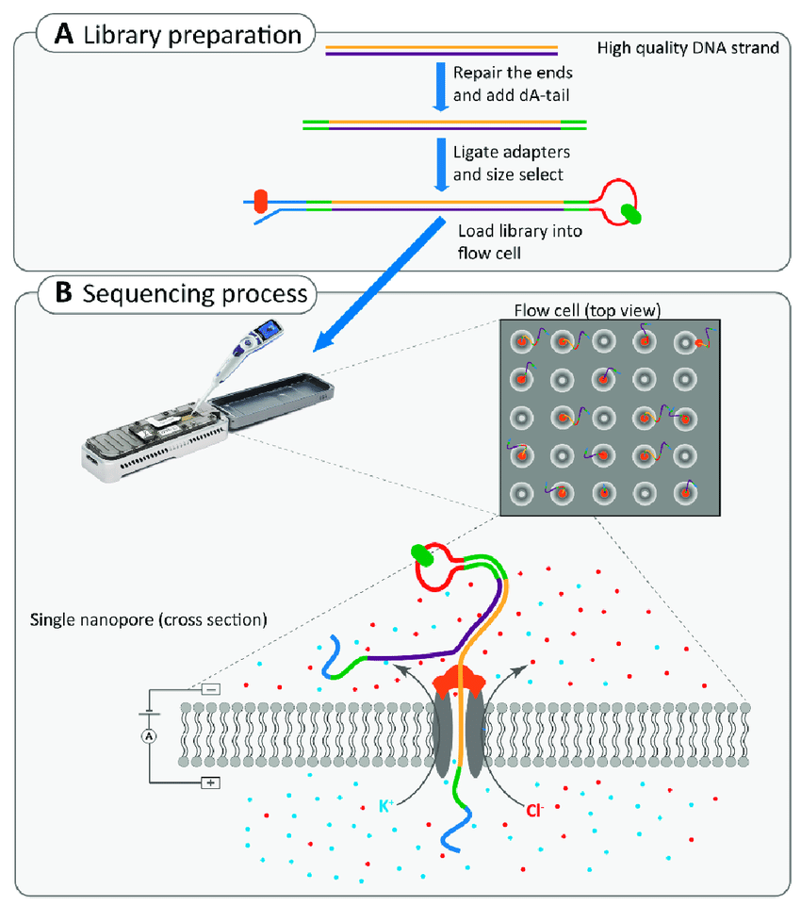
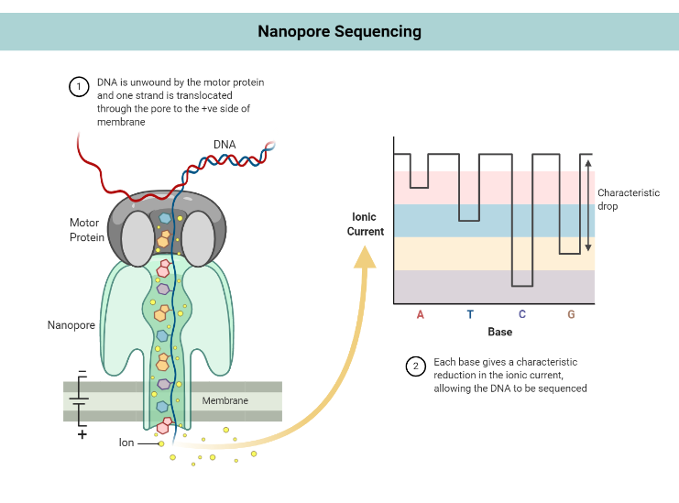
Nanopore Sequencing
source: Researchgate
14

Slide 15

15

Slide 16
Nanopore Sequencing offers several unique advantages, including:
Long Read Lengths
Real-Time Sequencing
Portability
Direct Detection of Base Modifications
While nanopore sequencing initially had lower accuracy compared to other methods, continuous improvements in pore engineering, base-calling algorithms, and sample preparation techniques have significantly enhanced its performance. Nanopore Sequencing has found applications in areas such as de novo genome assembly, structural variation analysis, transcriptomics, and metagenomics, among others.
16

Slide 17
Method | Accuracy | Applications
Sequencing by Synthesis | High | High throughput, cost-effective
Ion Semiconductor Sequencing | High | Fast, scalable
SMRT Sequencing | Very High | Epigenetic studies, long reads
Nanopore Sequencing | Variable | Real-time, field applications
17

Slide 18




future of DNA sequencing
18

Slide 19
References
SBS Illumina (Sequencing by Synthesis):
Mardis, E. R. (2008). Next-generation DNA sequencing methods. Annual Review of Genomics and Human Genetics, 9, 387-402. https://doi.org/10.1146/annurev.genom.9.081307.164359
Bentley, D. R., Balasubramanian, S., Swerdlow, H. P., Smith, G. P., Milton, J., Brown, C. G., ... & Smith, A. J. (2008). Accurate whole human genome sequencing using reversible terminator chemistry. Nature, 456(7218), 53-59. https://doi.org/10.1038/nature07517
Ion Semiconductor Sequencing:
Rothberg, J. M., Hinz, W., Rearick, T. M., Schultz, J., Mileski, W., Davey, M., ... & Bustillo, J. (2011). An integrated semiconductor device enabling non-optical genome sequencing. Nature, 475(7356), 348-352. https://doi.org/10.1038/nature10242
Rhoads, A., & Au, K. F. (2015). PacBio sequencing and its applications. Genomics, Proteomics & Bioinformatics, 13(5), 278-289. https://doi.org/10.1016/j.gpb.2015.08.002
SMRT Sequencing (Single Molecule Real-Time Sequencing):
Eid, J., Fehr, A., Gray, J., Luong, K., Lyle, J., Otto, G., ... & Turner, S. (2009). Real-time DNA sequencing from single polymerase molecules. Science, 323(5910), 133-138. https://doi.org/10.1126/science.1162986
Rhoads, A., & Au, K. F. (2015). PacBio sequencing and its applications. Genomics, Proteomics & Bioinformatics, 13(5), 278-289. https://doi.org/10.1016/j.gpb.2015.08.002
Nanopore Sequencing:
Deamer, D., Akeson, M., & Branton, D. (2016). Three decades of nanopore sequencing. Nature Biotechnology, 34(5), 518-524. https://doi.org/10.1038/nbt.3423
Jain, M., Olsen, H. E., Paten, B., & Akeson, M. (2016). The Oxford Nanopore MinION: Delivery of nanopore sequencing to the genomics community. Genome Biology, 17(1), 239. https://doi.org/10.1186/s13059-016-1103-0
Future of DNA Sequencing:
Goodwin, S., McPherson, J. D., & McCombie, W. R. (2016). Coming of age: Ten years of next-generation sequencing technologies. Nature Reviews Genetics, 17(6), 333-351. https://doi.org/10.1038/nrg.2016.49
Shendure, J., Balasubramanian, S., Church, G. M., Gilbert, W., Rogers, J., Schloss, J. A., & Waterston, R. H. (2017). DNA sequencing at 40: Past, present and future. Nature, 550(7676), 345-353. https://doi.org/10.1038/nature24286
19

Slide 20

Thank You...
20

